Slide 1
Introduction
Interface Design

Slide 2
Topics
Human performance model
UX vs UI
Benefits of making UX better
The history and goals of UX Design

Slide 3
Human Performance Model
Environment
People
Process
Performance
Task
Tool

Slide 4
UX vs UI
3 Views
UX = UI
UX > UI
UX ≠ UI
UI focuses on phenomena during usage
UX focuses on phenomena after usage

Slide 5
UX
Definition
The overall experience, in general or specifics, a user, customer, or audience member has with a product, service, or event.
About how a person feels about using a technical system.
A person’s perceptions and responses that result from the direct or indirect (anticipated) use of a product, system or service - by ISO
Totality of effects felt by user as result of interaction with
A (technical) system, device, or product
Within usage context
The overall experience a person has with a technical system

Slide 6
UX > UI View
From narrow focus on task performance to overarching characteristics of entire user experience
Emotion, social and cultural implications
Fun, style, art
Branding, reputation
Political, social, personal connection

Slide 7
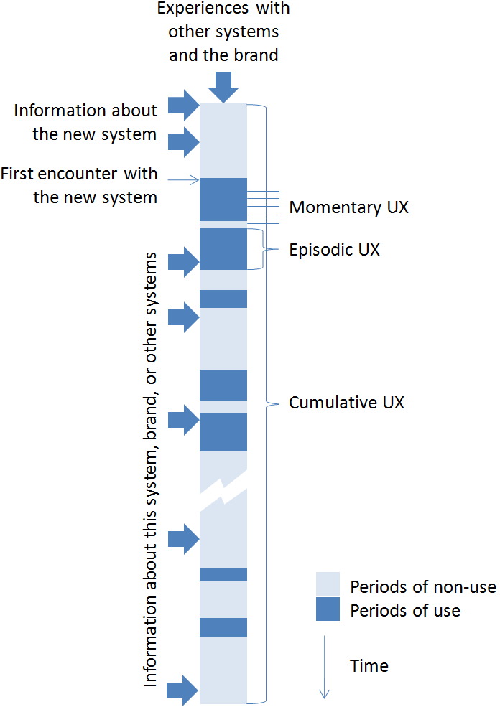
UX over time with periods of use and non-use

Slide 8
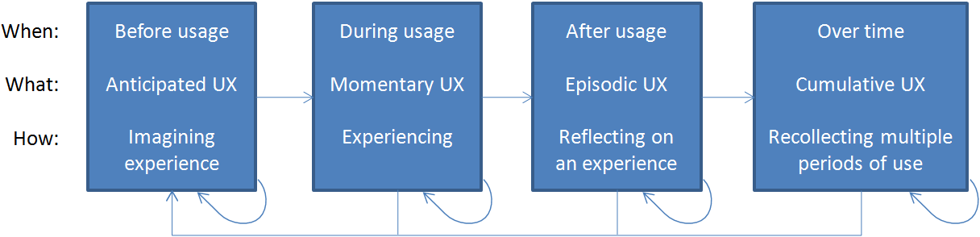
Time spans of user experience

Slide 9
Design
‘What is design?…It’s where you stand with a foot in two worlds — the world of technology and the world of people and human purposes—and you try to bring the two together’
(Mitch Kapor in T. Winograd Bringing design to Software (1996), p.1)

Slide 10
Design
The creative process of specifying something new
The representations that are produced along the way
e.g site map, blueprints, sketches, etc.
Typically involves many iterations
both problem and solution evolve during design
A spectrum of activities
Engineering design - using scientific principles
Architect designs buildings, urban planner designs roads, etc.
Artistic - creative design where imagination is key
Design as craft… design is a ‘conversation with materials’
E.g. pottery designer works with clay, clothes designer works with fabrics, interior designer works with furniture, paints, lighting, etc.
Our materials are interactive systems…
we work within and shape this medium
Such as phones, web sites, computer applications, mobile apps… any device or technical system that is interactive

Slide 11
UX Design
Definition
CX
the process of enhancing customer satisfaction and loyalty by improving the usability, ease of use, and pleasure provided in the interaction between the customer and the product.
any aspect of a person's interaction with a given technical system, including the interface, graphics, industrial design, physical interaction, and the manual.
encompasses traditional human-computer interaction (HCI) design and extends it by addressing all aspects of a product or service as perceived by users.
The process of specifying all aspects of human interaction with a technical system for a high-quality user experience,
Notes:
Kujala, Sari; Roto, Virpi; Väänänen-Vainio-Mattila, Kaisa; Karapanos, Evangelos; Sinneläa, Arto (2011). "UX Curve: A method for evaluating long-term user experience". Interacting With Computers 23 (5): 473–483. doi:10.1016/j.intcom.2011.06.005.
"What is user experience design?". IBM.
Peter Merholz (2007). "Peter in Conversation with Don Norman About UX & Innovation"

Slide 12
What is UX design about?
Environment
People
Task
Tool
Design - how to do the task
Technologies - what can technology do?
People - who will use it, who will be affected by it?
Activities and contexts - what will people have to do in what circumstances?

Slide 13
UX Design
Interaction
mutual or reciprocal action, effect, or influence
Interaction involves an exchange
Seeing, touching, and thinking about a technical system
Anticipation before any physical interaction
Entire experience during interaction
Savoring memory after interaction
Human
Very young to really old
Novices to experts

Slide 14
Benefits of making UX better
Gaining a competitive edge
Conversion rate: visit to purchase
Improving productivity
Reducing development and maintenance costs
Lowering support costs
Call center

Slide 15
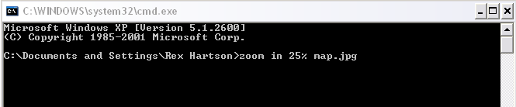
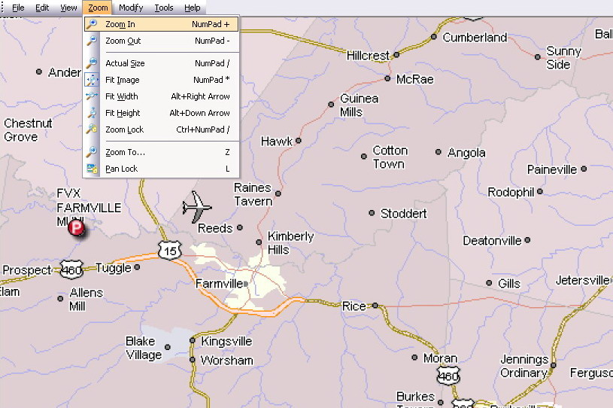
History of UX Design
Example - Larger map image
Before IT
With IT

Slide 16
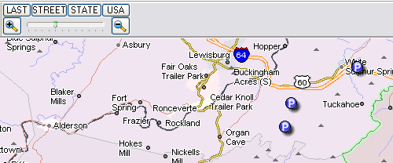
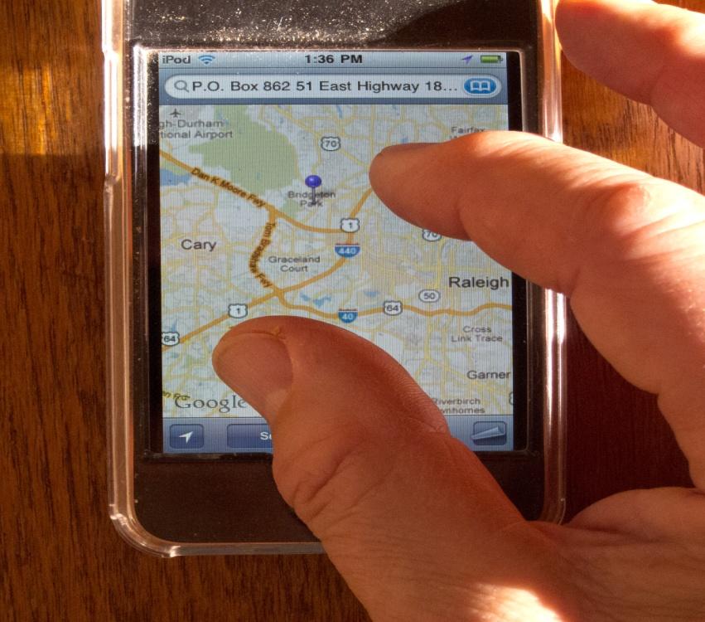
History of UX Design

Slide 17
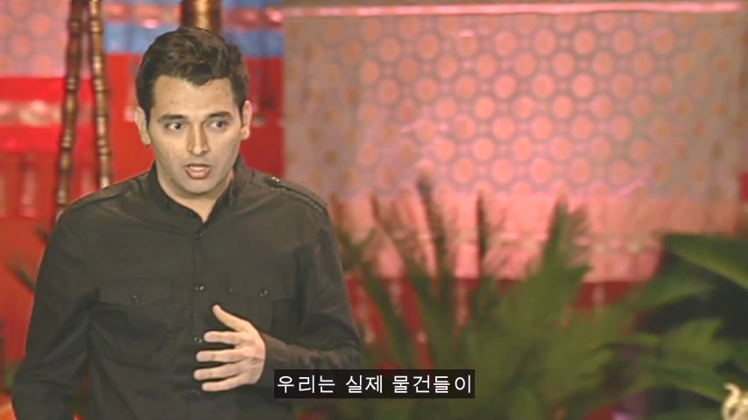
Future??
Sixth Sense??

Slide 18
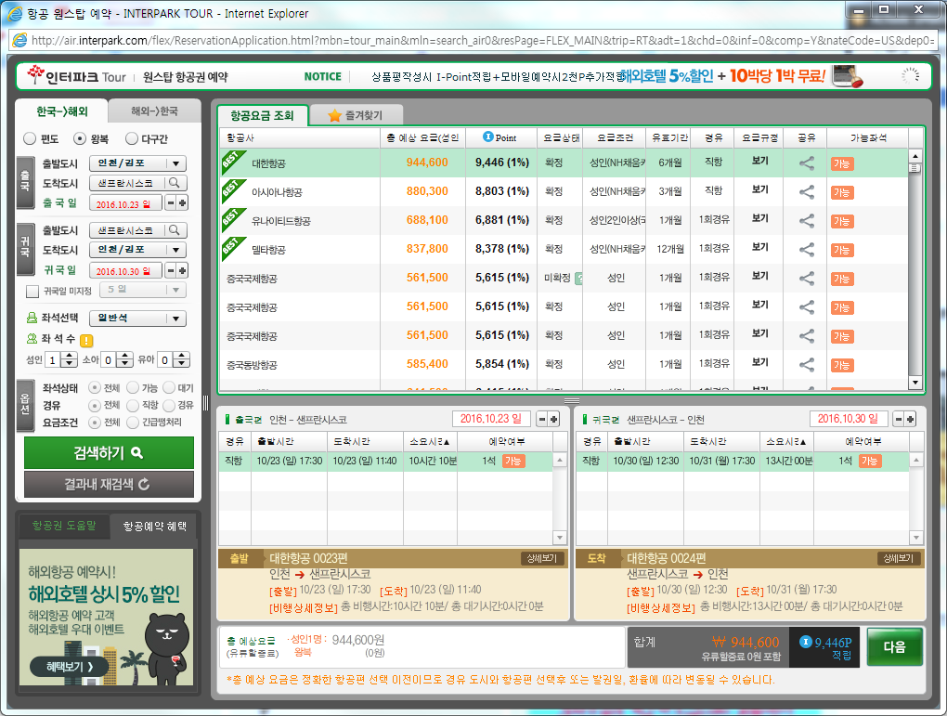
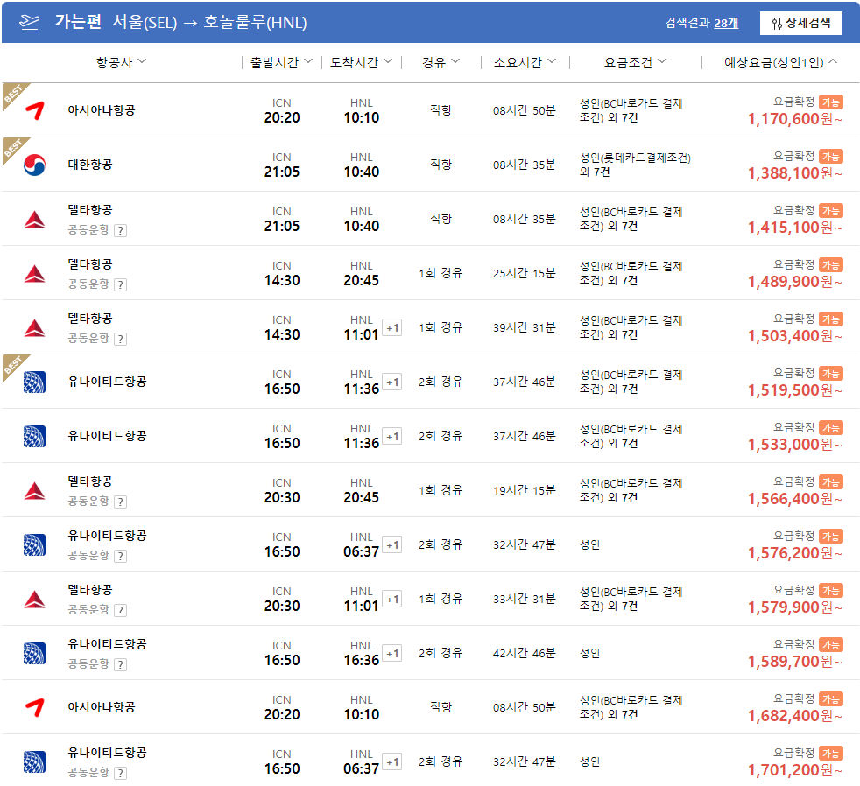
Airline reservation-INTERPARK

Slide 19
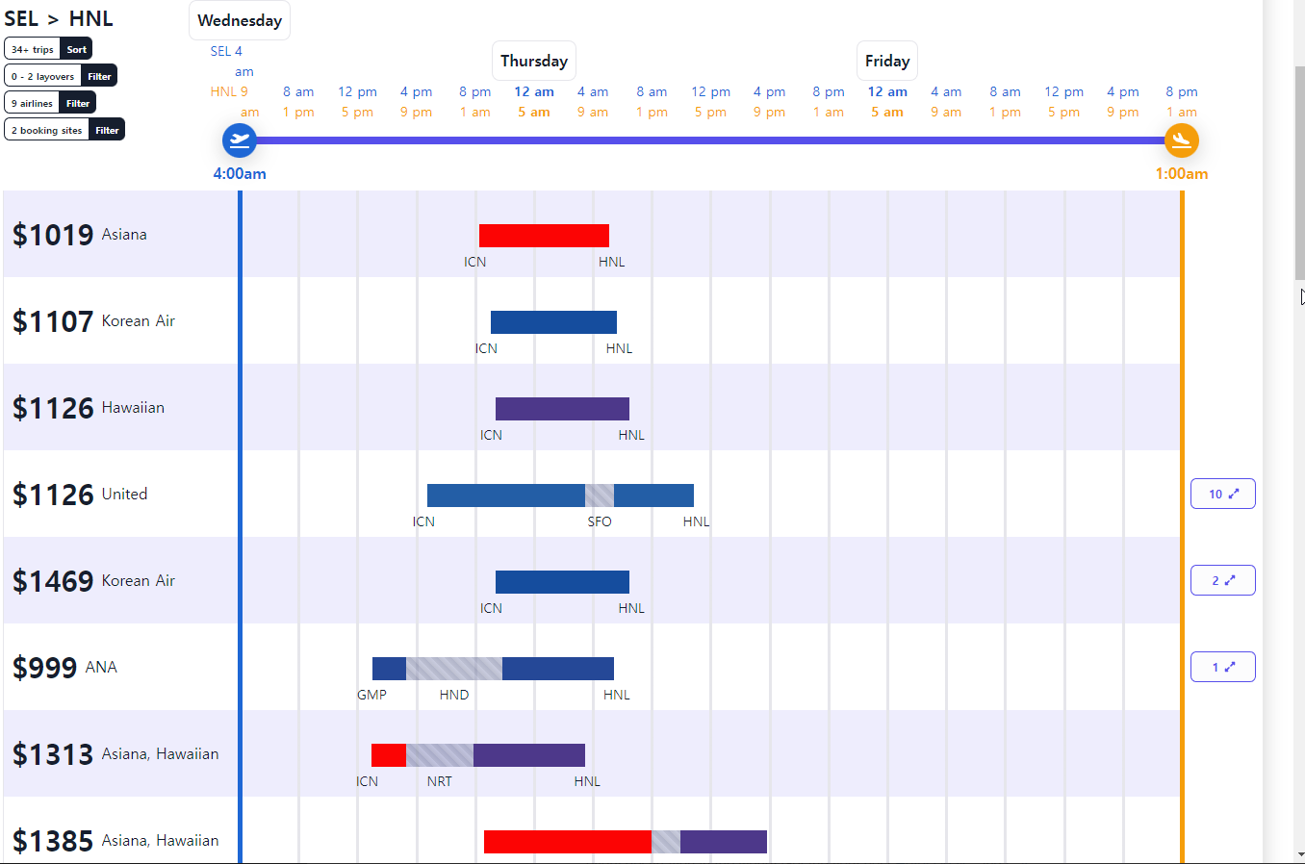
Airline reservation-Flight Penguin

Slide 20
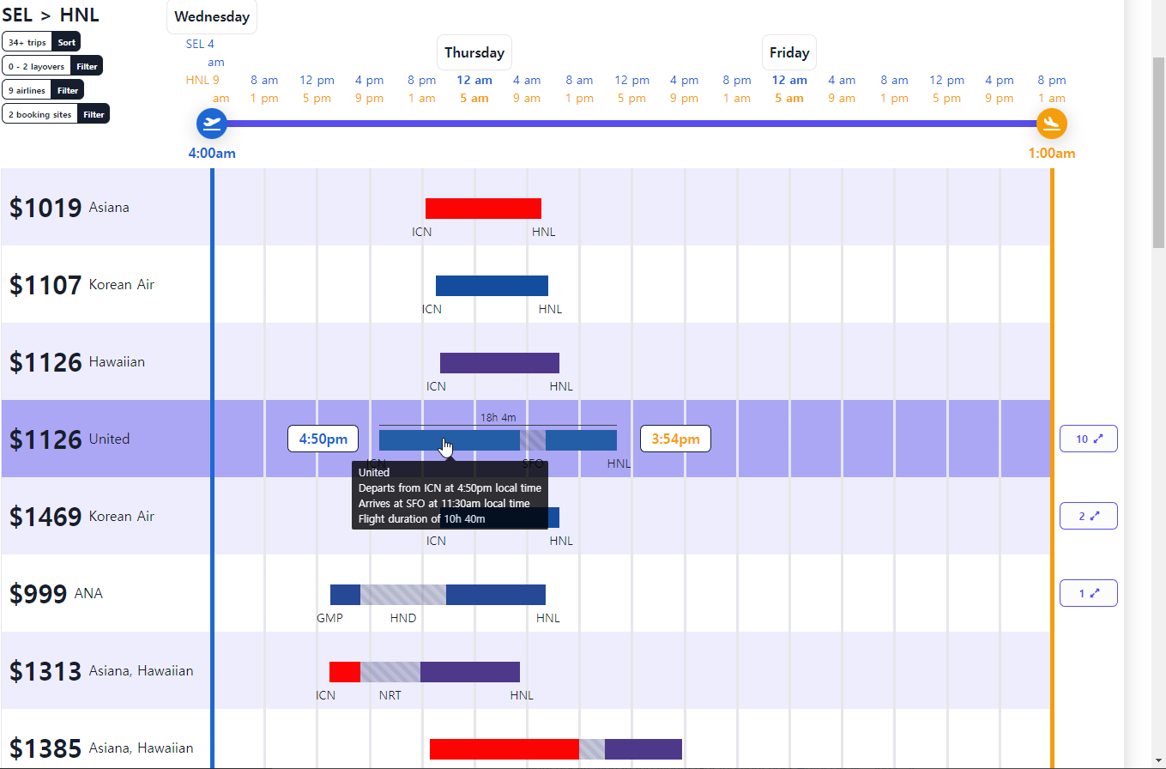
Airline reservation-Flight Penguin

Slide 21
UX Design Goals
Usability
Easy to learn
Easy to use
Idiot proof
Enjoyable to use
Esthetics
appealing
Usefulness
Efficiency
Effectiveness
Quality of life
Safety
Satisfaction
Comfort
of a technical system
Human-centred design
Notes:
Accessible, available, reliable

